Slide 1
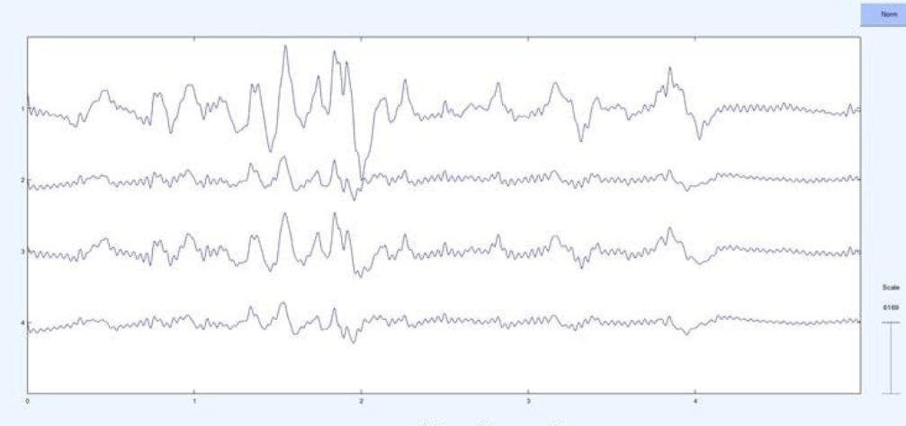
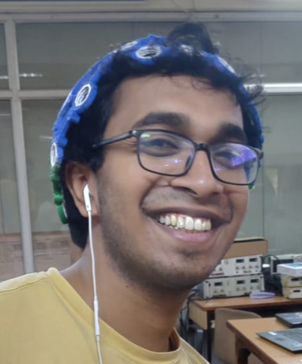
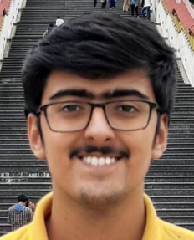
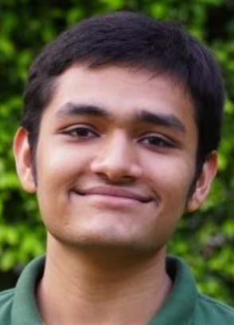
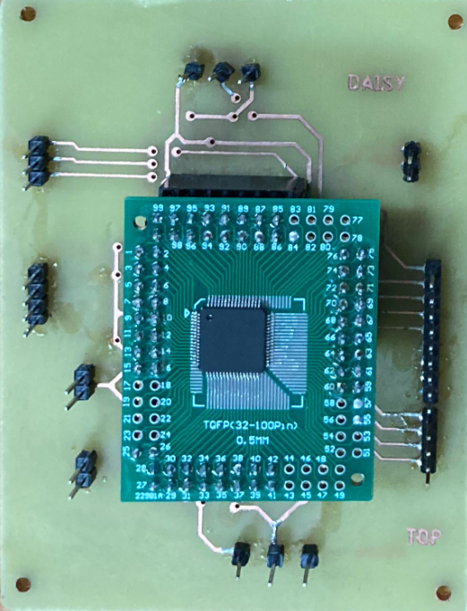
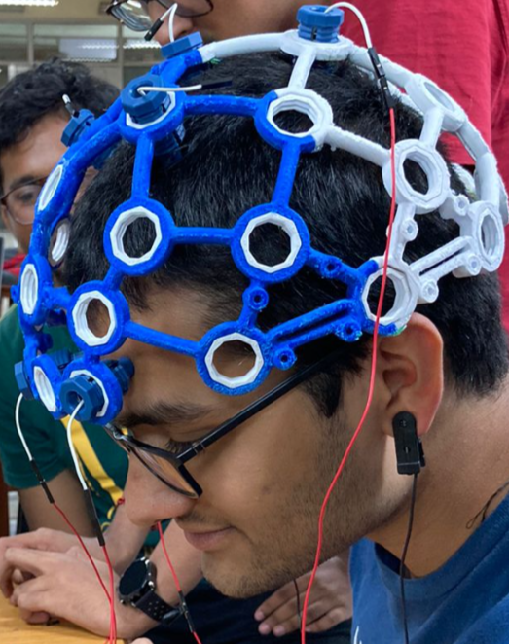


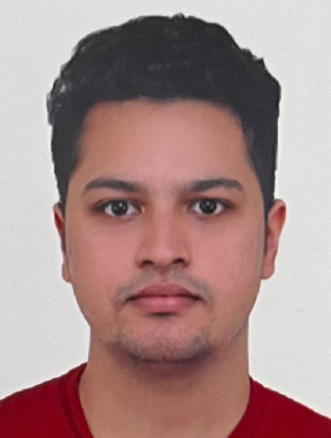
OpenBCI Based EEG Recording
End-to-End system for non-invasive brain signal acquisition and display of filtered relay data
4-channel brain signals acquired using contact electrodes and 3D printed headgear
Headgear with electrodes
Modular EEG acquisition device compatible with 4 differential ended electrodes
Aditya Aayush Shivam
Nithish Ankith Anubhav

